Slide 1
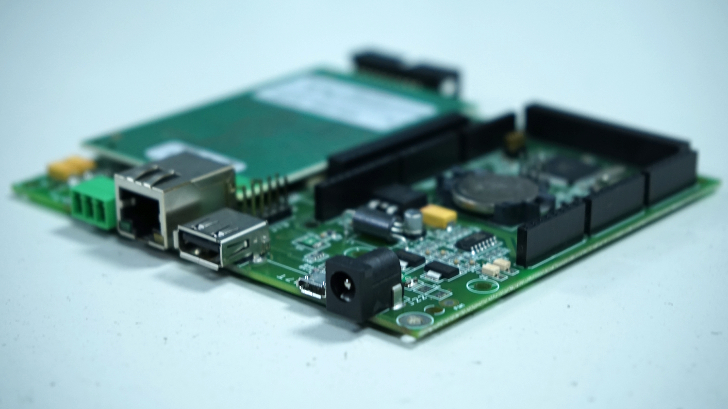
EMBEDDED SYSTEM CASE STUDY
AIR QUALITY MONITORING SYSTEM

Slide 2
TEAM MEMBERS
S.NO | ROLL NUMBER | NAME
1 | CB.EN.U4CSE21450 | HARECHARAN S
2 | CB.EN.U4CSE21455 | SHREYAS VISWESHWARAN
3 | CB.EN.U4CSE21466 | VIGNESH G
4 | CB.EN.U4CSE21468 | VISWAA RAMASUBRAMANIAN

Slide 3
Our area of interest
Raw statement : "Development of a Low-Cost, Raspberry Pi Pico-Based Air Quality Indicator Using a Seven-Segment Display"
Air quality is a critical environmental factor affecting public health and quality of life. In urban and industrial areas, monitoring air quality is crucial for identifying harmful levels of pollutants and taking appropriate measures. Traditional air quality monitoring systems can be expensive and complex, limiting their accessibility and usage in many communities.
Our perspective on this project is that this statement is a robust statement and it is a required problem to be solved and can serve well with the hardware components that we chose with consideration of the limited funds that we incur.

Slide 4

Objective
To design and develop a cost-effective, easy-to-implement air quality monitoring system using the Raspberry Pi Pico microcontroller.
The system will use an MQ-135 sensor to detect levels of various gases and present a simplified air quality status on a LCD display.
The display will show 'Good', 'Moderate', and 'Low' air quality, based on the concentration of pollutants detected.

Slide 5
Hardware components
Develop the firmware to process sensor data and control the display, translating air quality measurements into three simple categories (Good, Moderate, Low).
Raspberry Pi Pico as a central processing unit
Integrate the MQ-135 sensor for air quality measurement
Employ a seven-segment display for a clear, user-friendly visual output
Ensure the system is compact, energy-efficient, and scalable for potential enhancements like adding wireless data transmission or additional sensors

Slide 6
Challenges expected to face
Calibration and accuracy of the MQ-135 sensor.
Developing an efficient algorithm to categorize air quality levels.
Ensuring system stability and reliability over extended periods.

Slide 7
Expected Output - Deliverables
A working prototype of the air quality monitoring system.
Firmware source code and documentation.
A schematic of the circuit and a block diagram of the system.
A user manual explaining system operation and maintenance.

Slide 8
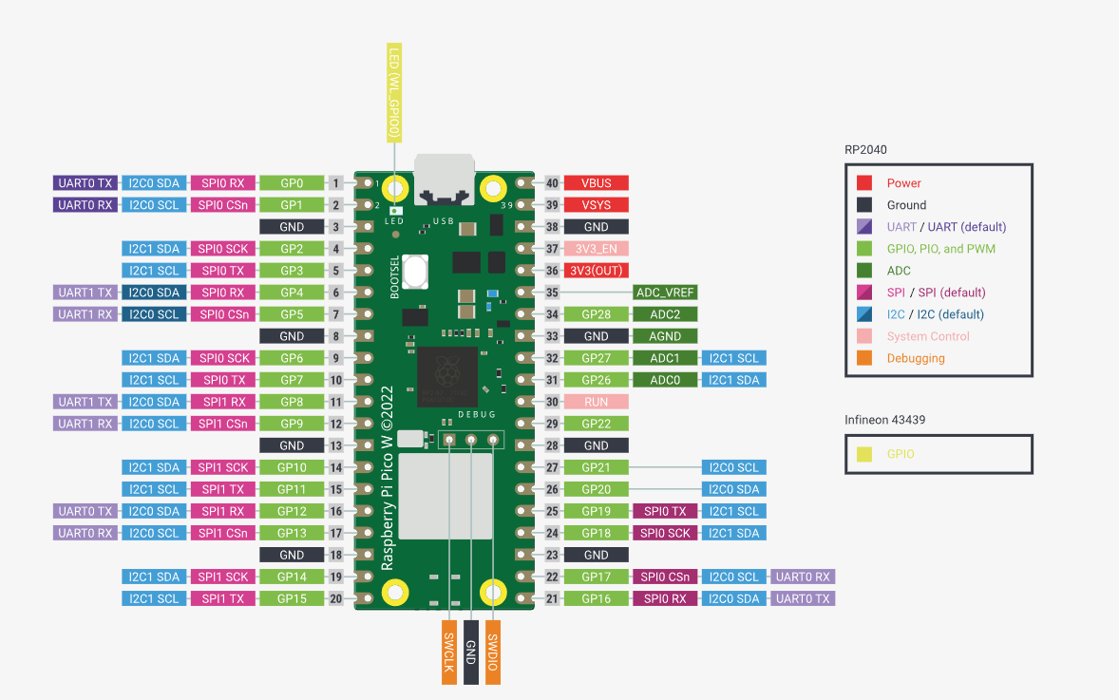
PIN DIAGRAM
PINS USED:
RED LED: PIN 2
YELLOW LED: PIN 3
GREEN LED: PIN 14
BUZZER: PIN 11
UART: DEFAULT ENABLED

Slide 9
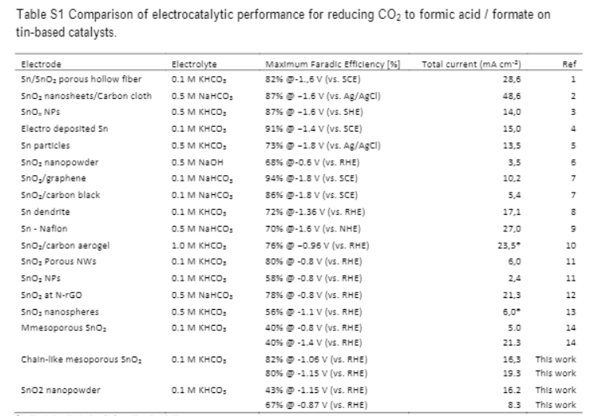


How does the Air Sensor Work?
MQ135 Sensor is made up of sno2 nanofibers that changes its conductivity (much like a semiconductor) and senses the changes in air composition with electrical currents
But caution! Do not expose to corrosive substances!

Slide 10
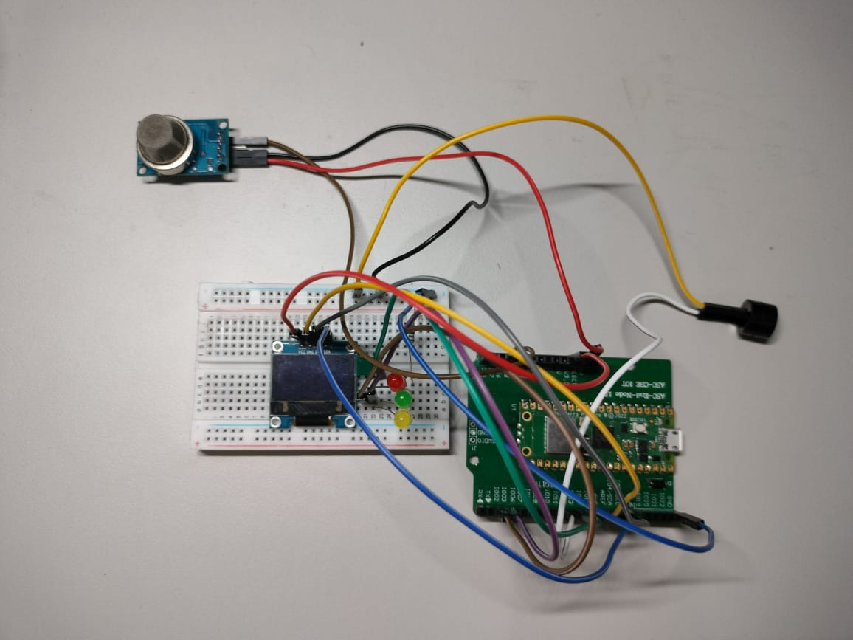
CIRCUIT DIAGRAM

Slide 11




MODEL RECALIBERATION

Slide 12

THANK YOU

